Slide 1
More about CSS Style Rules
Advanced Display Techniques
Non-HTML documents & Printer-friendly pages
COMP 105

Slide 2
Advanced topics
Rollover buttons
Pop-up images
Non-html links & Printing

Slide 3
Advanced Display
Techniques
Rollover buttons
Pop-up images

Slide 4
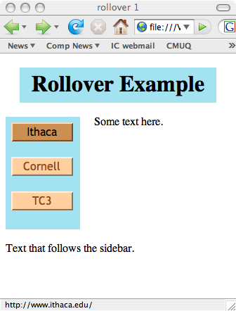
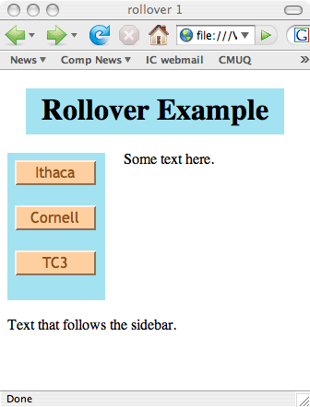
Rollover Buttons
CSS can be used to create rollover buttons that change their appearance when the mouse hovers over them

Slide 5
Rollover Buttons
Technique:
a {
display:block; padding:2px; width:5em; margin:2px;
text-decoration: none;
color:#8D4F10;
font-family: "Trebuchet MS", Verdana, sans-serif
}
    Display:block turns an anchor tag from an in-line element into a block element.
      This makes the links go down the left side of the page as blocks
    Removes the underlining
    Sets the color to darkish brown
    Specifies font family

Slide 6
Pseudo-classes for rollover buttons
Give unvisited and visited links a light orange background and an outset border of the same color to make it look like a button
a:link, a:visited {background:#FFCFA0;
border:2px outset #FFCFA0; }
Give buttons that are hovered over (or that have focus) a darker background and border, as well as black text
a:focus, a:hover {background: #CD8E51;
border:2px outset #CD8E51; color:black}
Give active buttons (when they are clicked) an even darker background
a:active {background:#AF6A27;border:2px outset #AF6A27}

Slide 7
Example: rollOver.html
h1
{ text-align: center; background-color: #A3E2F1;
height:30px; margin:20px; padding: 10px;
}
a
{ display:block; padding:2px; width:5em; margin:3px;
text-decoration: none;
color:#8D4F10;
font-family: "Trebuchet MS", Verdana, sans-serif
}
a:link, a:visited {background:#FFCFA0; border:2px outset #FFCFA0; }
a:focus, a:hover {background: #CD8E51; border:2px outset #CD8E51; color:black}
a:active {background:#AF6A27;border:2px outset #AF6A27}
.sidebar
{ width: 96px; height: 150px; float:left;
background-color:#A3E2F1;
margin-right: 20px; margin-bottom: 20px;
padding: 5px;
}
.button {text-align:center}
.newSection {clear:both}

Slide 8
Example: rollOver.html
<body>
<h1>Rollover Example</h1>
<div class="sidebar">
<div class="button">
<a href="http://www.ithaca.edu">Ithaca</a> <br />
<a href="http://www.cornell.edu">Cornell</a> <br />
<a href="http://www.tc3.edu">TC3</a>
</div> <!-- end class button -->
</div> <!-- end class sidebar -->
<div>
<p >
Some text here.
</p>
</div>
<div class="newSection">
Text that follows the sidebar.
</div>
</body>

Slide 9
Example: rollOver.html
a
{ display:block; padding:2px; width:5em; margin:3px;
text-decoration: none;
color:#8D4F10;
font-family: "Trebuchet MS", Verdana, sans-serif;
}
.sidebar
{ width: 96px; height:150px;
float:left;
background-color:#A3E2F1;
margin-right: 20px; margin-bottom: 20px;
padding: 5px;
}
.newSection {clear:both}
Clears the floating so that it appears below the sidebar.

Slide 10
Pop-up Photo Album
To create a photo album, we want to have small thumb images of the photos and show the full size image as a pop-up when the viewer moves the mouse over a thumb image.

Slide 11
First Steps
First, prepare small thumb images in an image editor (use image → resize in Photoshop Elements)
In the source code, create a separate paragraph <p> for each image and <img> tags to display the thumb images.

Slide 12
Style rules for thumb <img>
Create style rules for no border (for the thumbs) and a bottom margin for <p> elements (for spacing).
  <style type="text/css ">
  img.mini {border:none}
  p {margin-bottom:26px}
  </style>

Slide 13
A frame for display
Create a frame on the web page where the large images will be displayed
In <head> <style>
  #frame { position:absolute; top:60px; left:165px;
  height:375px; width:500px;
  border:2px solid red;
  font: 1em "Trebuchet MS", Verdana, sans-serif;
  color:red;padding:10px}
In <body>
<div id="frame">
<p>Hover mouse over the photos to enlarge them
into this box.</p>
</div>

Slide 14
Image links
Make each thumb image and its full size version dual image links
<p>
<a class=photo title="Athens" href=
"../images/athens1.jpg">
<img class="mini" src="../images/athensThmb.jpg"
alt="Athens" height="108" width="144">
<img class="big" src="../images/athens1.jpg"
alt="Athens" >
</a>
</p>

Slide 15
Pseudo-classes for <div> box
Name the <div> box where the photos will be displayed using an id
<div id="minis">
Define hover pseudo-class for the thumbs (as image links)
div#minis a:hover {background:white}
Hide the big (full size) image by making its width and height 0
div#minis a img.big {height: 0; width: 0; border-width: 0}
Make the big (full size) image appear in the frame when the mouse hovers over one of the thumb images
div#minis a:hover img.big { position:absolute;
top:70px; left:175px;
height:375px;width:500px;
border:none}

Slide 16
Non-HTML documents & Printer-friendly pages
COMP 105
Dr. Ioana Coman

Slide 17
Reading/Printing Web Pages
Some Web pages can be very difficult to read online
  ads
  blinking images
  too long -- want to read at leisure
Also, people often want to print a web page
  Reservation confirmation
  Online purchase receipt
  Research, archives of reference sources

Slide 18
Suggestions for printing
The following are suggestions …
  Change to black print on white background
  Use fonts and font sizes that work best for printing
    Serif fonts
    Point size (not pixels) of 11 or 12
  Underline links
  No navigation sidebars
  Remove (if possible) advertising
  Include copyright notice, if applicable
  Include original URL
  Remove flash and animated images

Slide 19
Style sheets
Different style sheets can be created for
  Screen (monitor) version
  Print version
  <link rel="stylesheet" media="screen" type="text/css" href="screenStyle.css"
  <link rel="stylesheet" media="print" type="text/css" href="printStyle.css"

Slide 20
Black on white, font-size
body {
background: white;
font-size: 12pt;
}
h1, h2, h3 {color: black; background: transparent; }

Slide 21
Margins, floats, padding
#wrapper, #content {
width: auto;
margin: 0 5%;
padding: 0;
border: 0;
float: none !important;
color: black;
background: transparent none;
}
div#content {
margin-left: 10%;
padding-top: 1em;
border-top: 1px solid #930;
}

Slide 22
Links
a:link, a:visited {
color: #520;
background: transparent;
font-weight: bold;
text-decoration: underline;
}

Slide 23
Testing
Test by viewing the page in browser and use
File → Print preview
to see what would be sent to a printer
Note that the browser automatically selects the appropriate style sheet for the intended media

Slide 24
Displaying other kinds of files
In this course, our focus has been web pages
What about using links to display other kinds of files?
  pdf
  Spreadsheet
Why?
  A common use of the web is to publish white papers – documents that provide documentation, a user guide, or research results that are not published elsewhere.

Slide 25
PDF files
PDF is a format for documents that are created using Adobe Acrobat
Use the HTML anchor <a href=> tag
  <a href="WebSiteUsability.pdf">usability</a>
When the link is clicked, the browser may open the PDF document in a window or may launch an Acrobat viewer as a helper application (depending on how the browser options are set).

Slide 26
Links to spreadsheets
Use the <a href=> tag
  <a href="WeatherSheet.xls">spreadsheet</a>
  The viewer must have spreadsheet software (for example, Excel or installed on their
  computer to view the file.
Excel (and most spreadsheet software) contains a File → Save as option that allows you to save the spreadsheet as a prepared web page.
Example: WeatherSheet.htm

